Slide 1
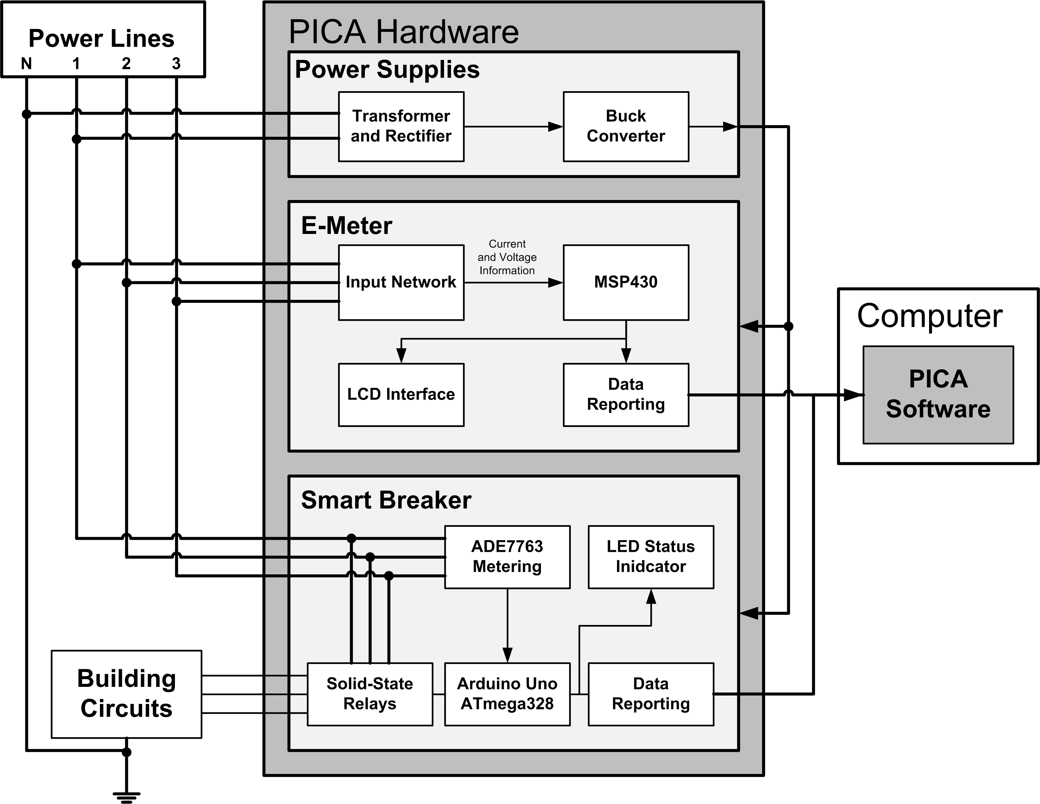
System Diagram

Slide 2
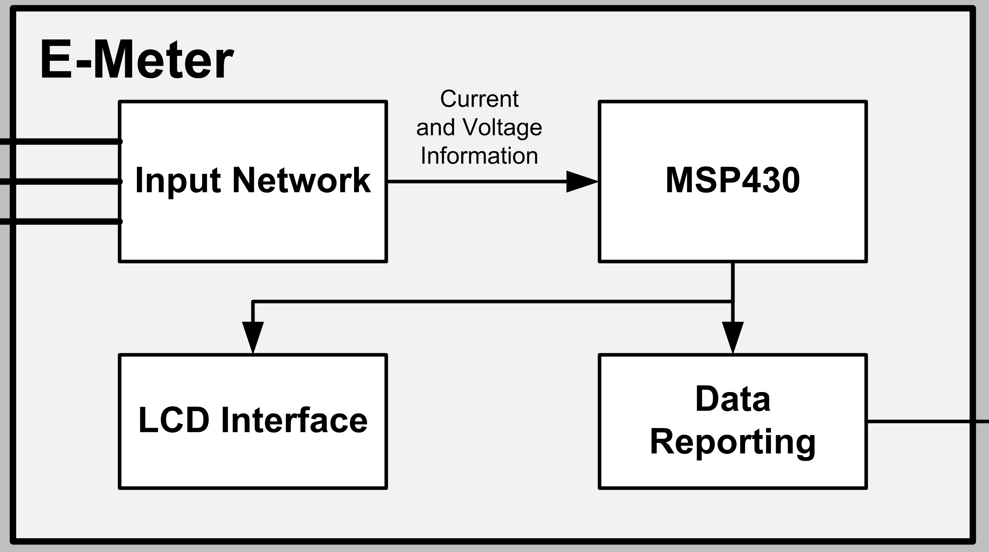
E-Meter Block Diagram

Slide 3
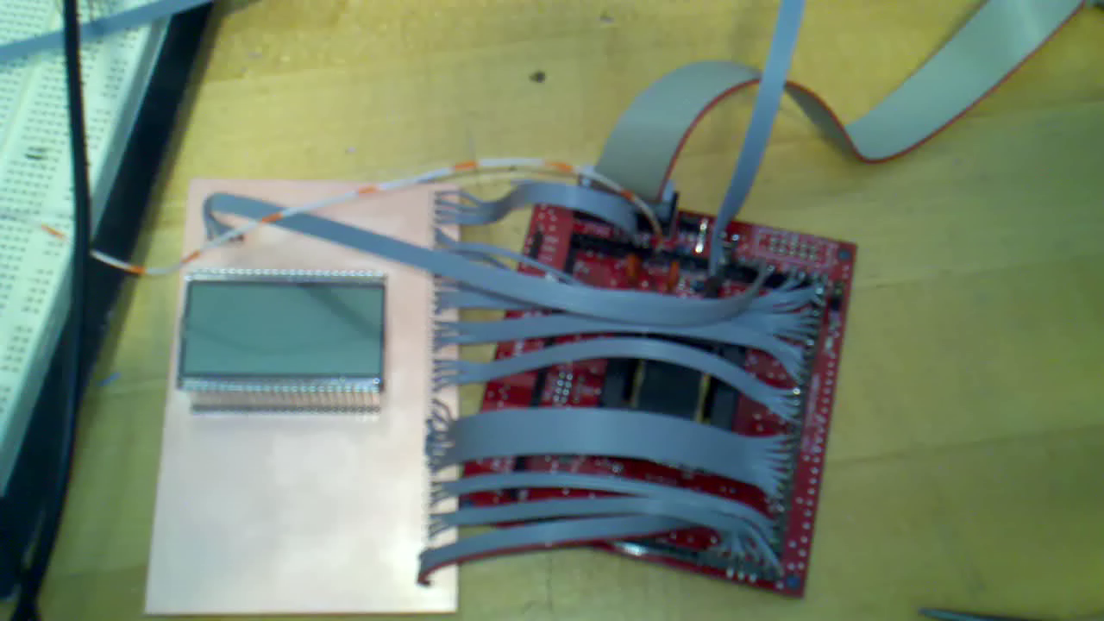
LCD Demonstration

Slide 4
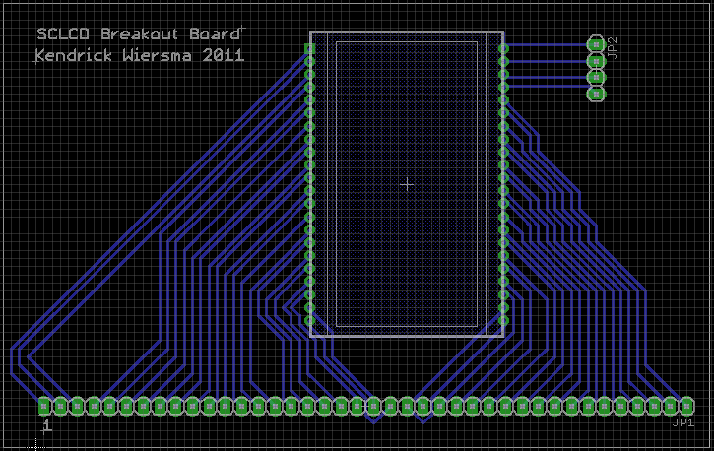
SCLCD Breakout Board

Slide 5
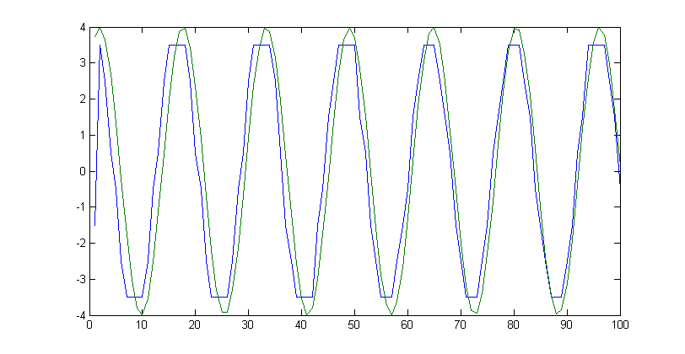
4-Bit Current Transmission

Slide 6
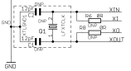
MSP430 Clocking

Slide 7
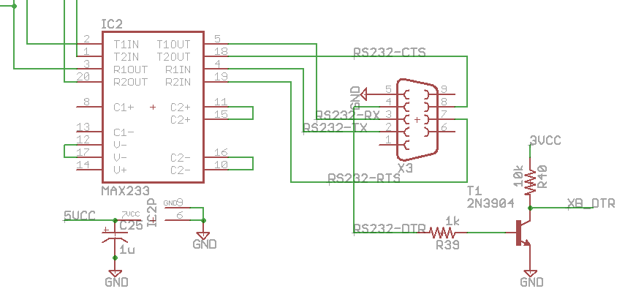
E-Meter RS232

Slide 8
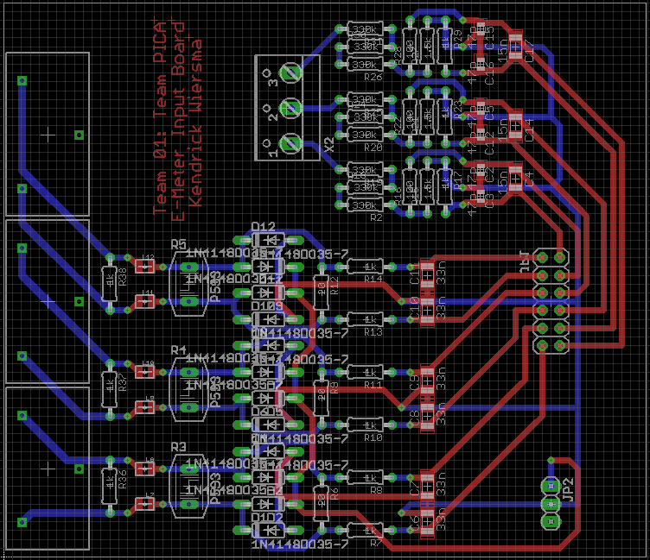
E-Meter Input Board

Slide 9
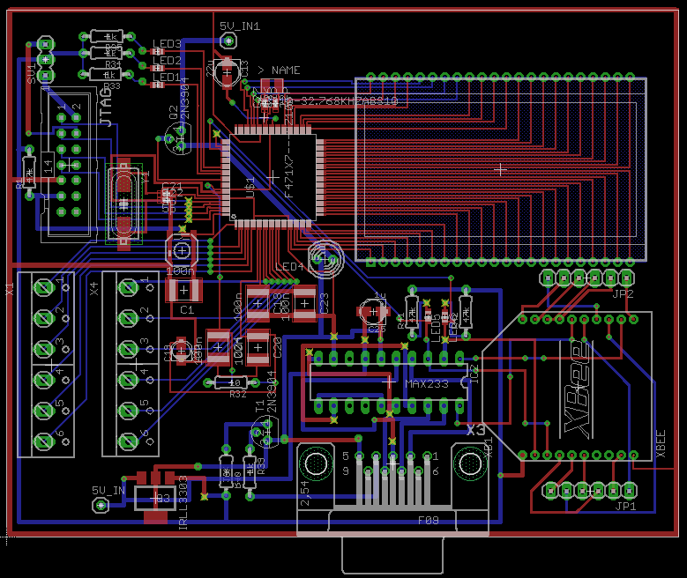
E-Meter Main Board

Slide 10
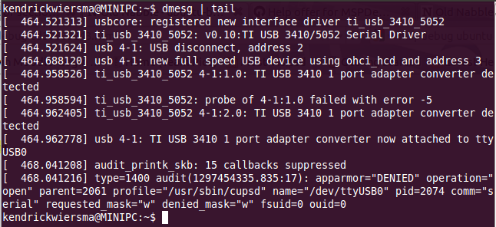
MSPGCC Debugging

Slide 11
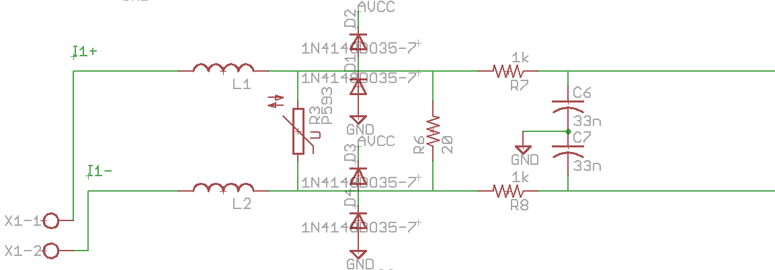
E-Meter Current Sense Circuit

Slide 12
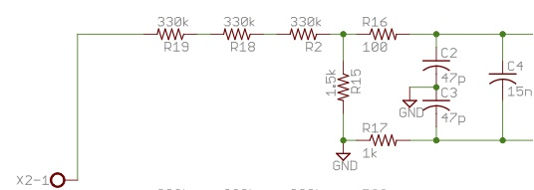
E-Meter Voltage Shunt

Slide 13
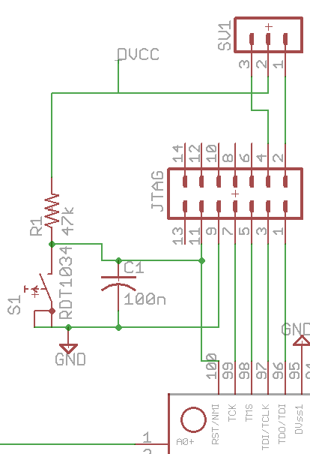
E-Meter JTAG Circuit

Slide 14
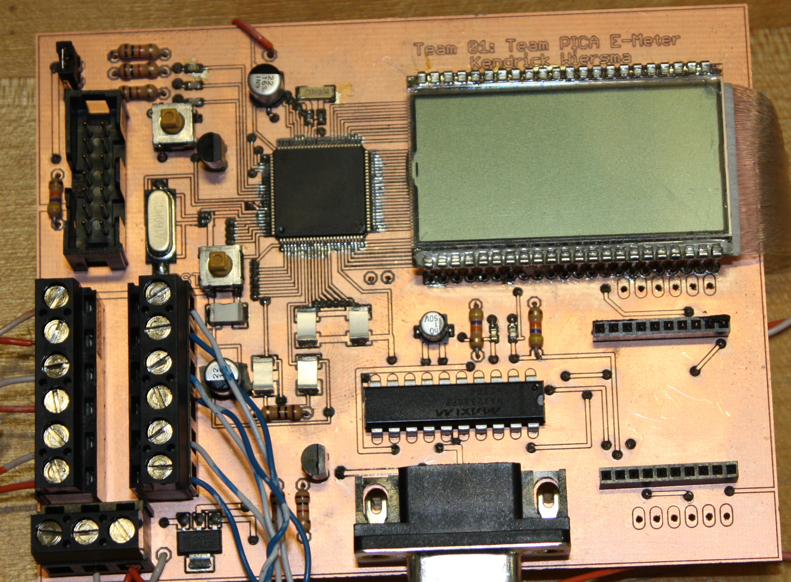
E-Meter Main Prototype

Slide 15
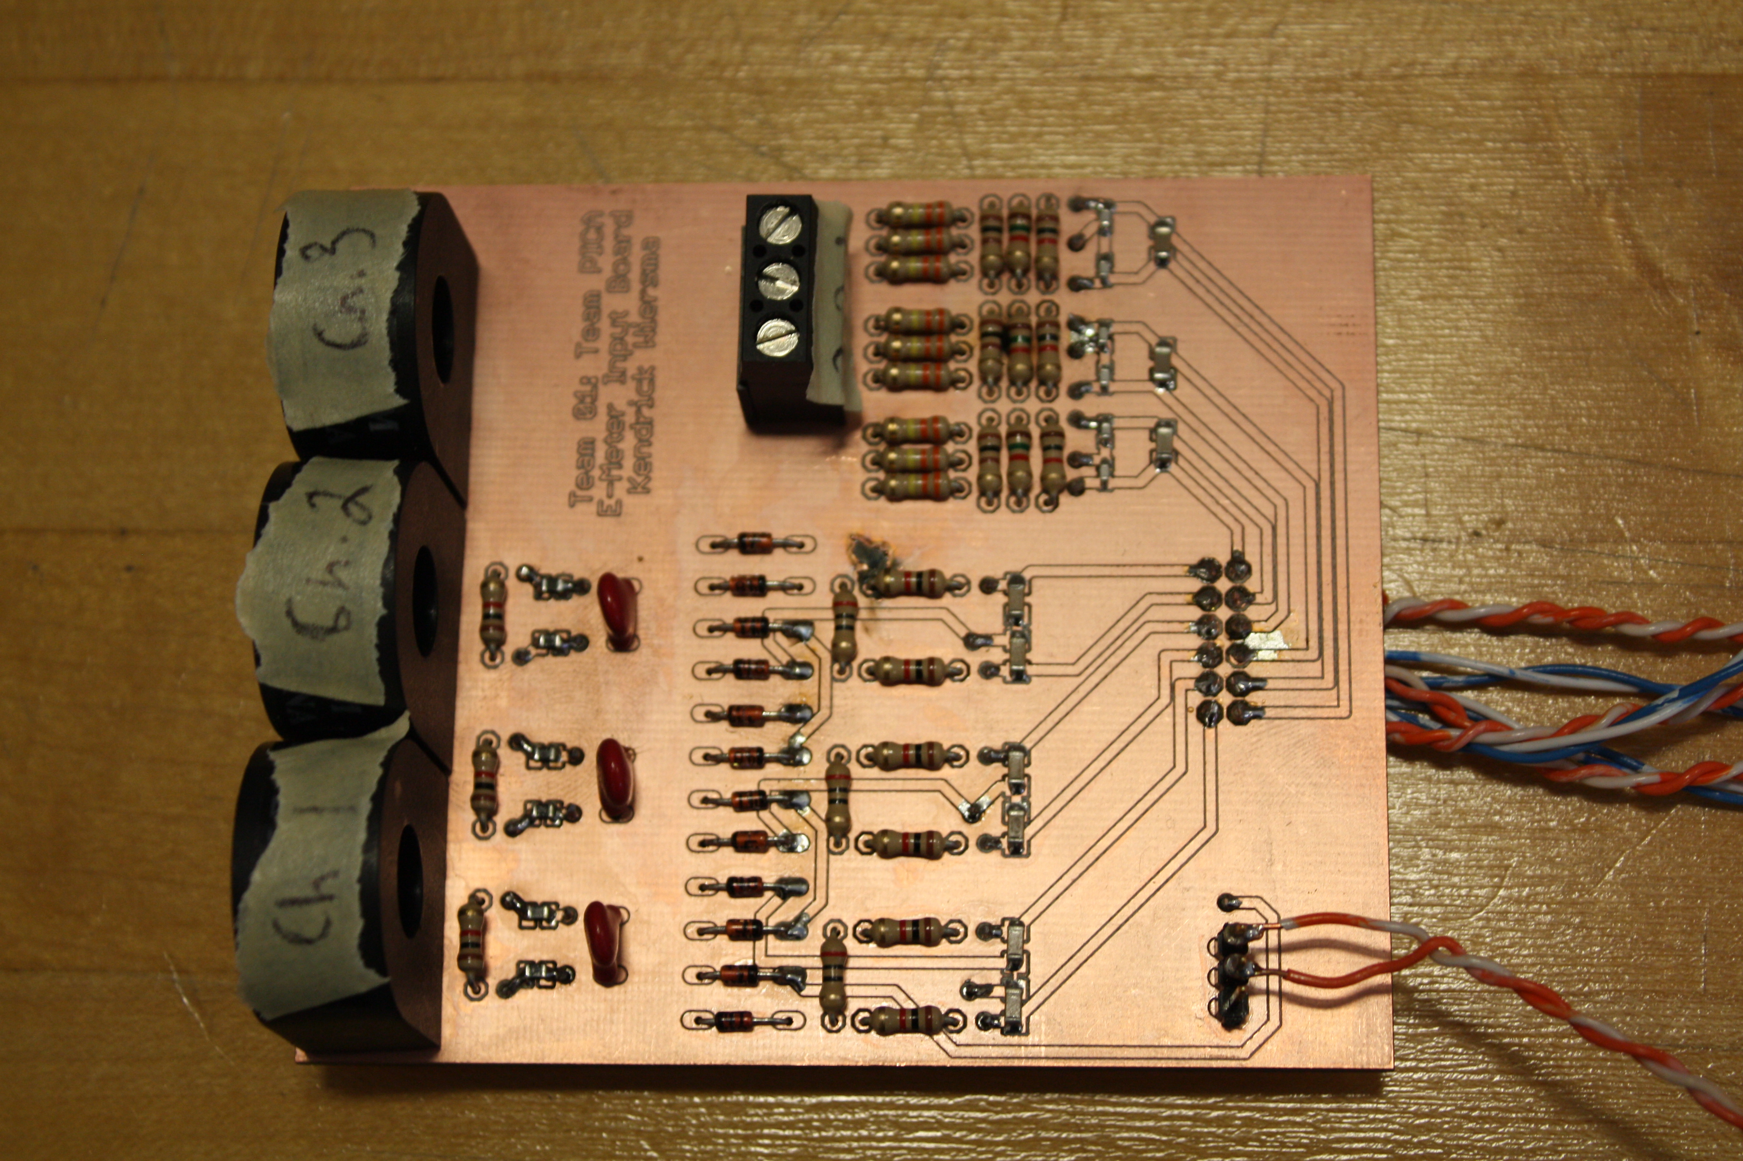
E-Meter Input Board Prototype

Slide 16
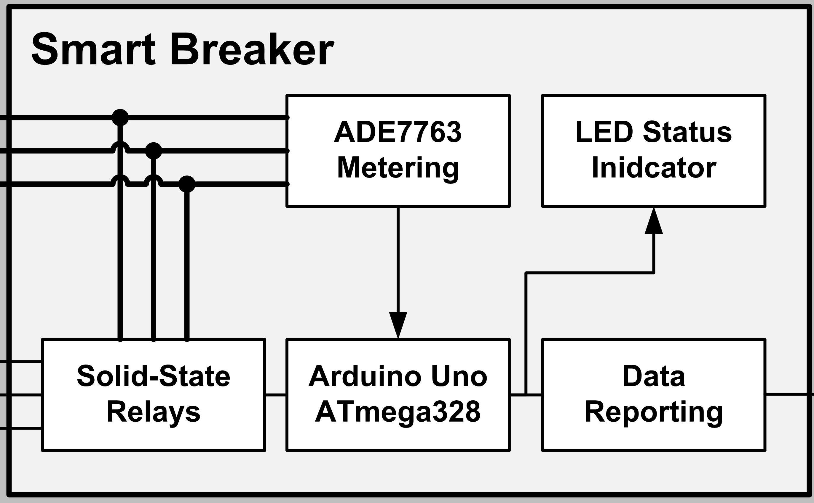
Smart Breaker Block Diagram

Slide 17
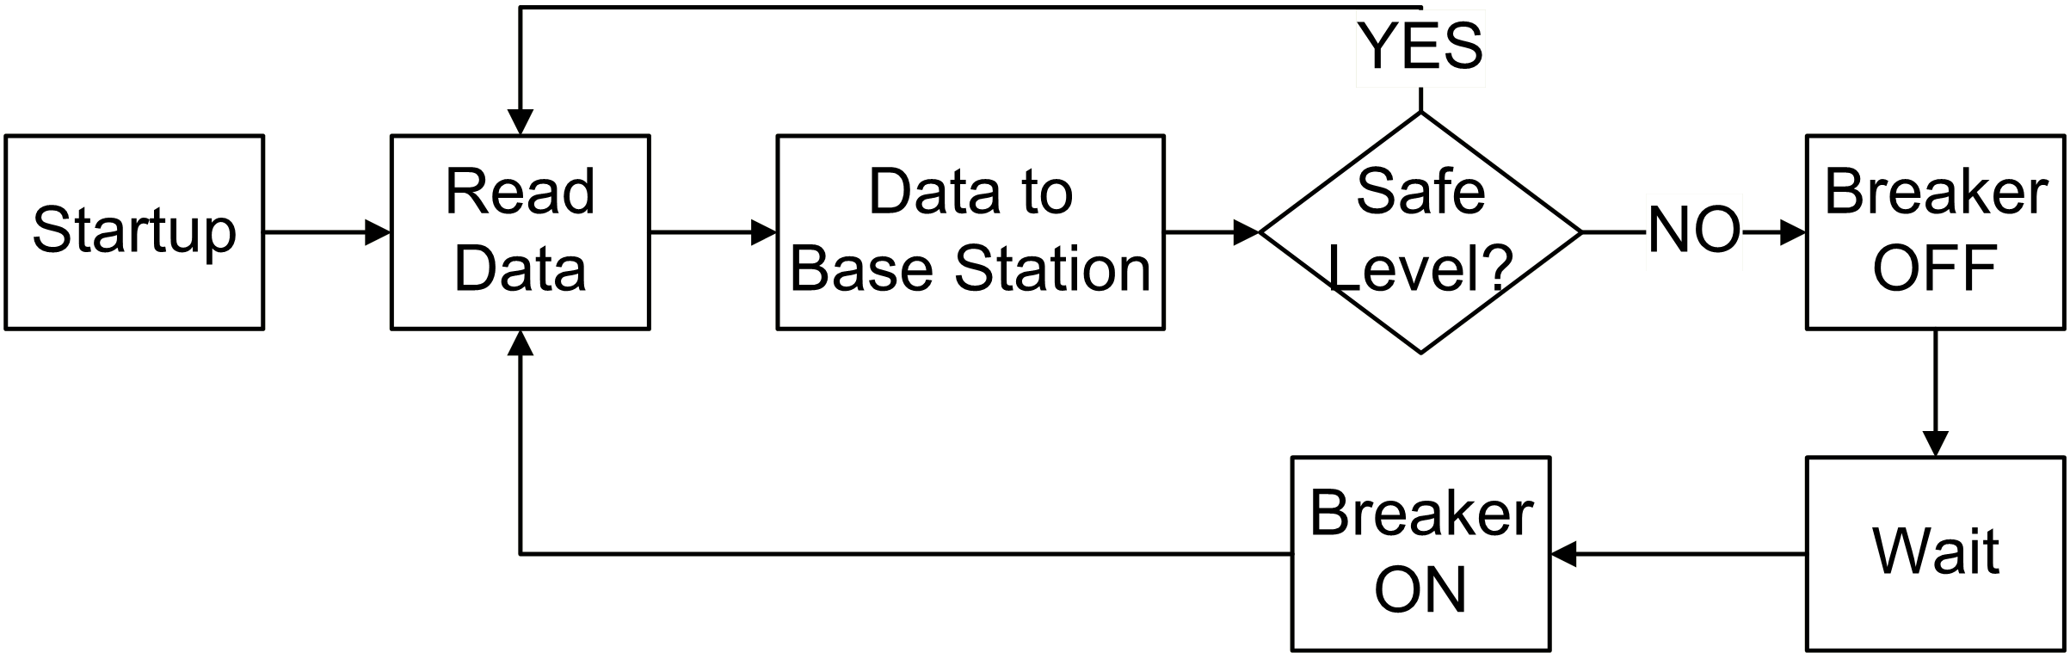
Smart Breaker Software Flow

Slide 18
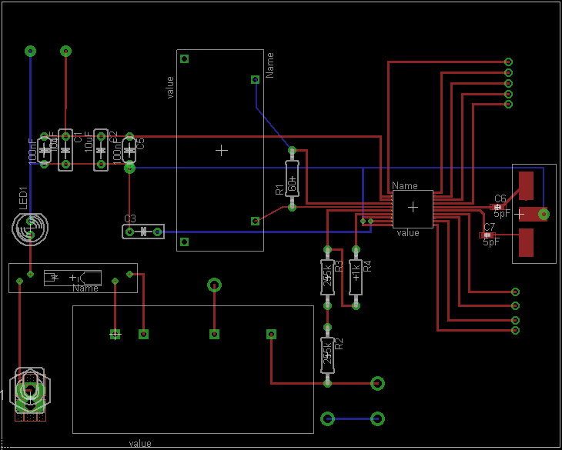
Smart Breaker PCB

Slide 19
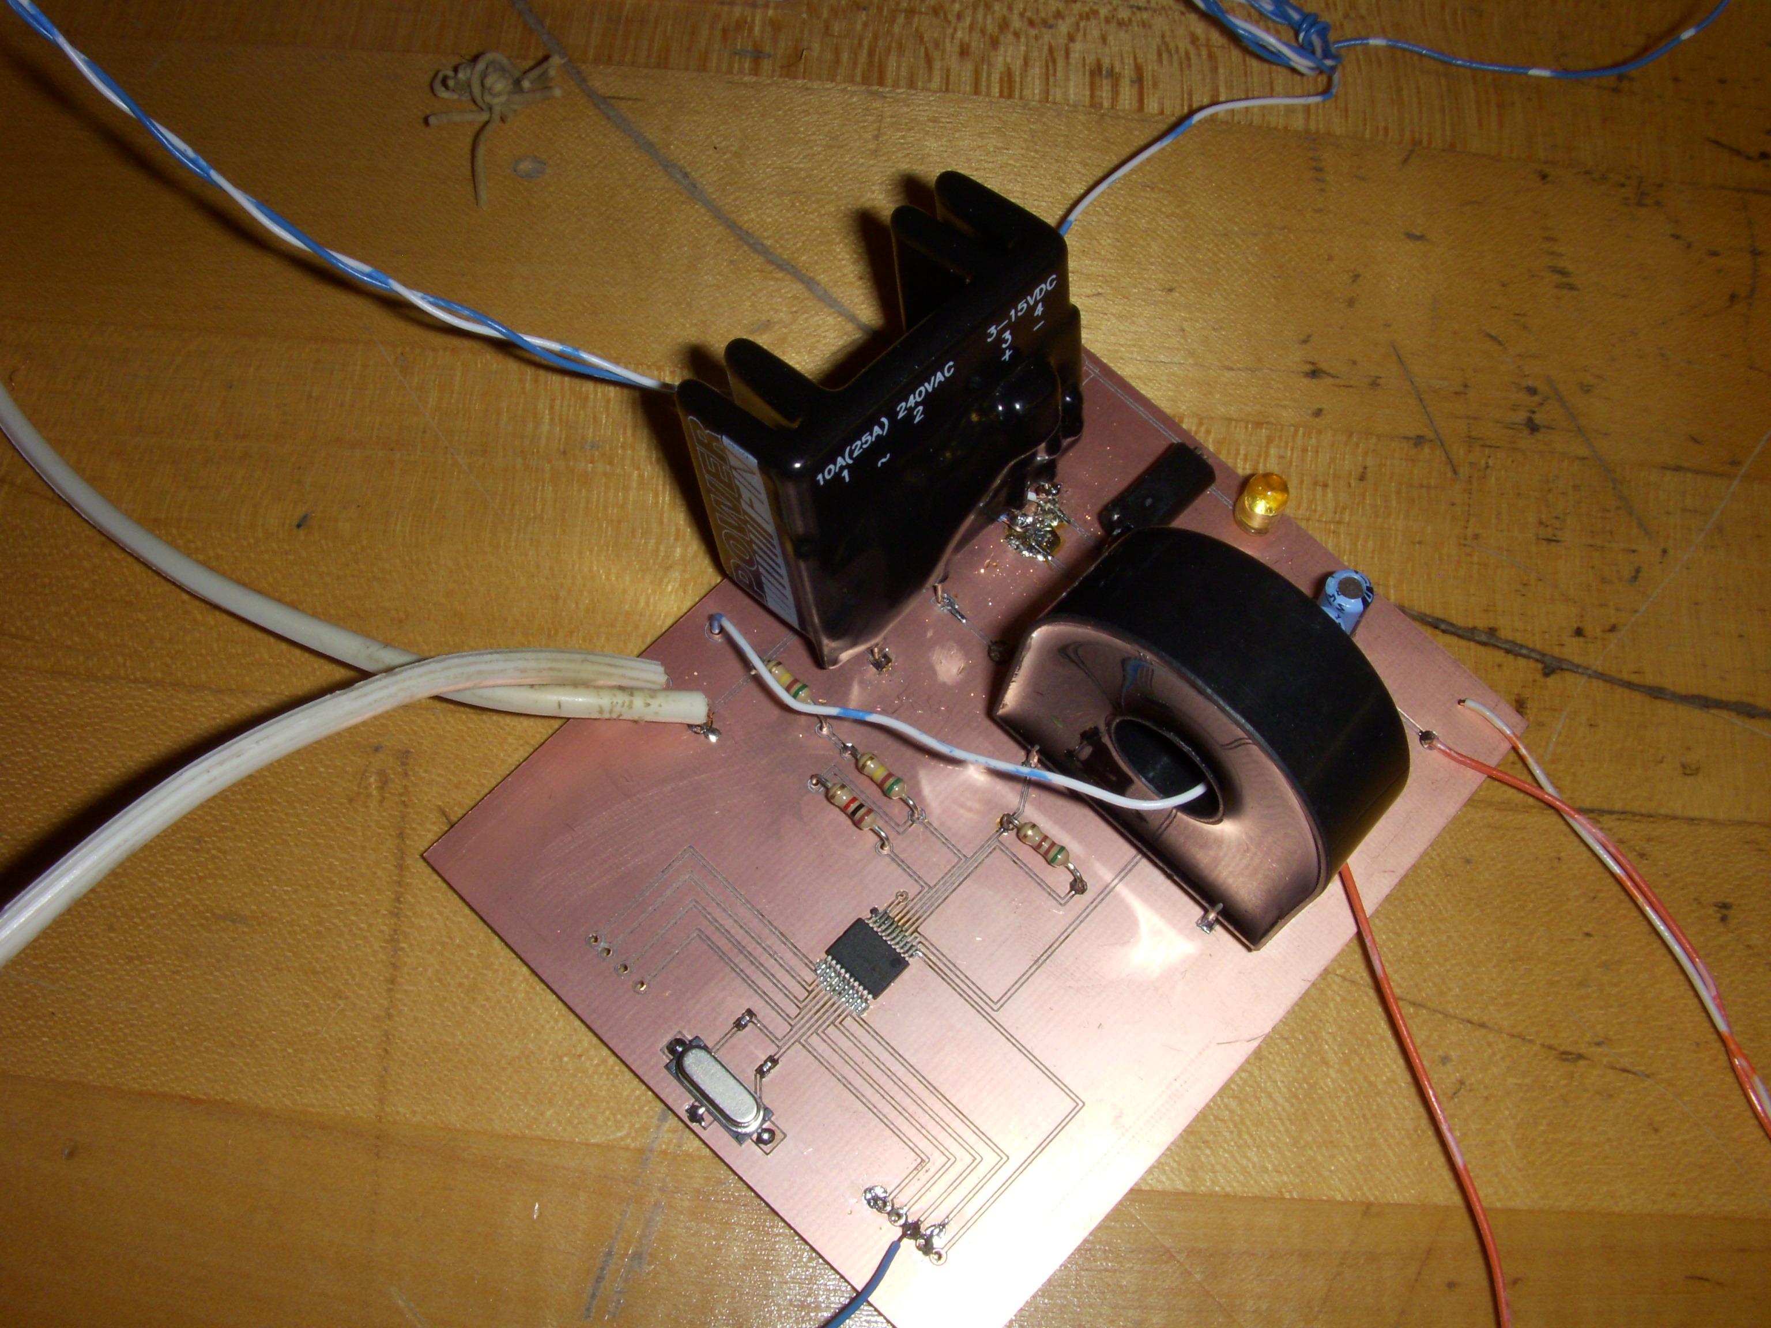
Smart Breaker Prototype

Slide 20
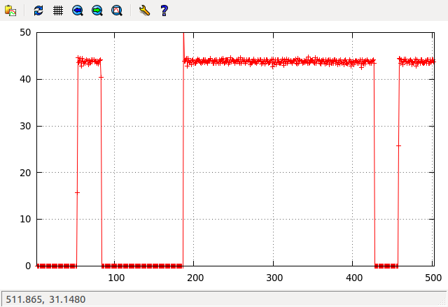
Base Station Data Plot

Slide 21
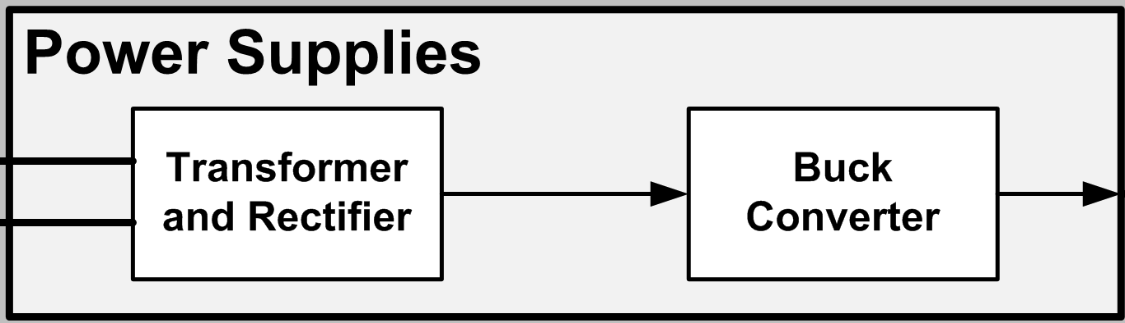
Power Supply Block Diagram

Slide 22
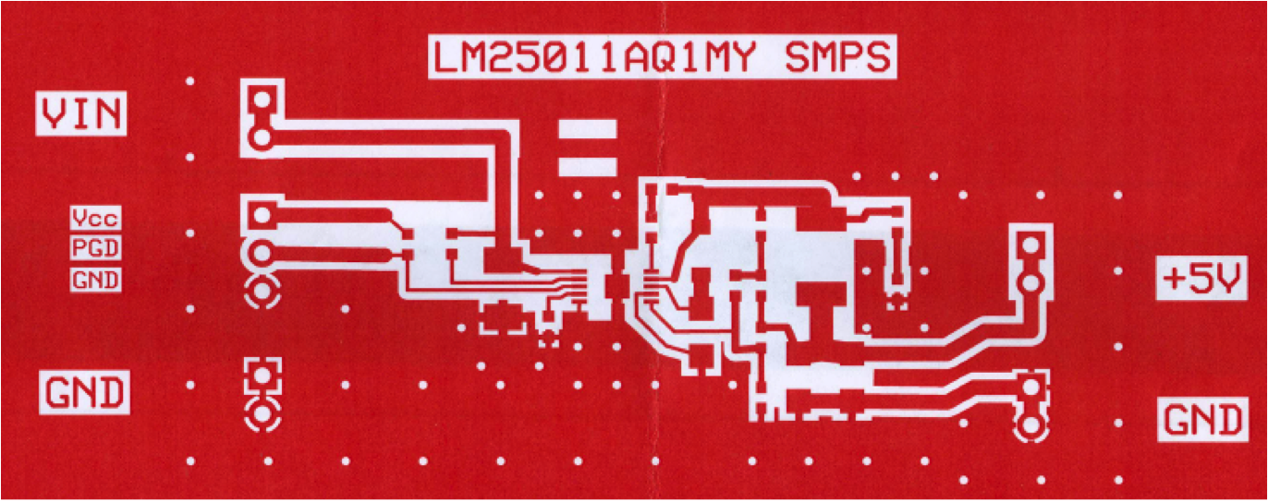
Power Supply PCB

Slide 23
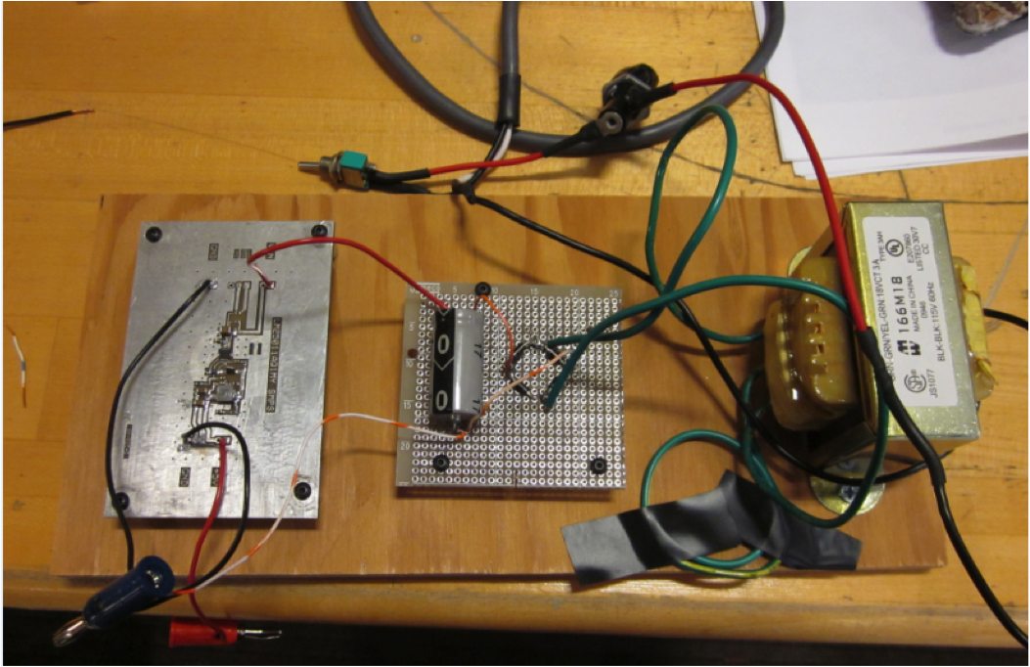
Power Supply Prototype

Slide 24
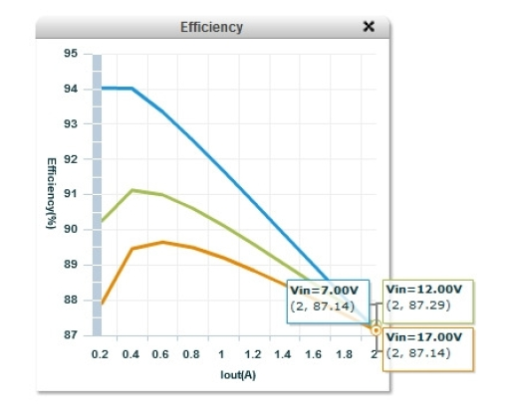
Power Supply Efficiency

